Slide 1
AWS S3 integrated with Snowflake
Project by:
Adinarayana Murthy Bikkina

Slide 2



Objective:
The objective of the task involves obtaining information from an S3 bucket, transforming the input data with Glue ETL, and loading the results into the Snowflake database.

Slide 3
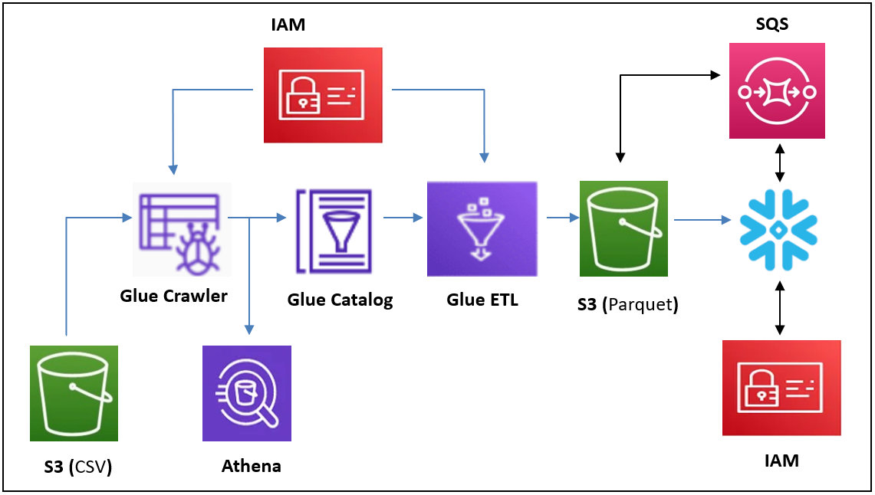
Project Architecture

Slide 4
Project structure:
Create S3 bucket in AWS
Create IAM roles
Create AWS glue crawler
Create AWS glue ETL job
Configure connections between AWS S3 and snowflake

Slide 5
Step 1: Create S3 bucket in AWS
Amazon S3 is object storage built to store and retrieve any amount of data from anywhere. S3 is a simple storage service that offers industry leading durability, availability, performance, security, and virtually unlimited scalability at very low costs.
Create a S3 bucket (etl-project-s3-by-adi) to store source data, target data and scripts.

Slide 6
Step 2: Create IAM roles in AWS
AWS Identity and Access Management (IAM) roles are entities you create and assign specific permissions to that allow trusted identities such as workforce identities and applications to perform actions in AWS. When your trusted identities assume IAM roles, they are granted only the permissions scoped by those IAM roles.
Create an IAM role for glue crawler and glue ETL job with below policies.
Name – etl-project-iam-role1-by-adi
Policies – clouldwatchfullaccess, amazons3fullaccess, awsglueservicerole
Create an IAM role to integrate AWS S3 with snowflake with below policies.
Name – etl-project-iam-role2-by-adi
Policies –amazons3fullaccess

Slide 7
Step 3: Create glue crawler in AWS
A crawler accesses your data store, extracts metadata, and creates table definitions in the AWS Glue Data Catalog. The Crawlers pane in the AWS Glue console lists all the crawlers that you create. The list displays status and metrics from the last run of your crawler.
Create crawler with name etl-project-crawler-fetch-from-s3input-by-adi
Read data from s3 using AWS glue Crawler
Create partition in s3 and upload file.
s3://etl-project-s3-by-adi/input/product/year=2021/product_data_2021.csv
etl-project-iam-role1-by-adi IAM role have permission of s3 fullaccess, cloudwatch fullaccess and AWSGlueServiceRole.
It will automatically create year column as partition column. you can see data in athena.
If we add another folder year=2022 , than we need run crawler again.
s3://etl-project-s3-by-adi/input/product/year=2022/

Slide 8
Step 4: Create glue etl job in AWS
AWS Glue ETL supports extracting data from various sources, transforming it to meet your business needs, and loading it into a destination of your choice. This service uses the Apache Spark engine to distribute big data workloads across worker nodes, enabling faster transformations with in-memory processing.
Create Glue etl job (etl-project-read-from-s3job-by-adi) using pyspark.
Read data from product table which create by etl-project-crawler-fetch-from-s3input-by-adi and convert into parquet format by glue etl.
Create output file in s3://etl-project-s3-by-adi/output/
Provide IAM role etl-project-iam-role1-by-adi
We can give script path s3://etl-project-s3-by-adi/scripts/
The temporary path is s3://etl-project-s3-by-adi/temp/

Slide 9
Step 5: Configure connections between AWS S3 and snowflake
Create data warehouse, database and schema in snowflake
Obtain data from S3 bucket s3://etl-project-s3-by-adi/output/
Create fileformat name as parquet_formatt
etl-project-iam-role2-by-adi IAM role have permission of s3 fullaccess and SQS fullaccess.
Create storage integration by providing STORAGE_ALLOWED_LOCATIONS ("s3://etl-project-s3-by-adi/output/newproduct/") and STORAGE_AWS_ROLE_ARN (enter IAM role(etl-project-iam-role2-by-adi) ARN value)
Create stage by providing URL (s3 output path s3://etl-project-s3-by-adi/output/), STORAGE_INTEGRATION (sto_int name AWS_INTG) and file_format (name of created file format " “parquet _formatt")
Create external table with name product
Get notification channel name from created external table and paste it into bucket properties.

